Slide 1
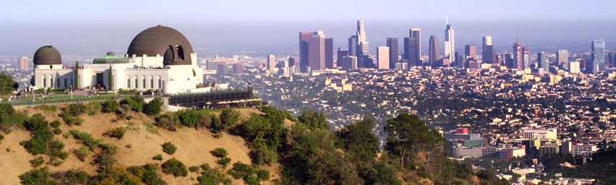

AIR POLLUTION
TEAM: MAGICAL LIGERS
TEAM MEMBERS: HYUN SOO KIM, NAZIA HAQUE, WAYNE TSENG, CHRISTIAN POMPA
DATE: 5/19/20
”IT'S PRETTY MUCH MY FAVORITE ANIMAL. IT'S LIKE A LION AND A TIGER MIXED... BRED FOR ITS SKILLS IN MAGIC.” - NAPOLEON DYNAMITE

Slide 2
MOTIVATION & SUMMARY
How bad is Air Pollution in the US?
Motivation:
LA is smoggy, wanted to know what our standards are.
How aware the US population is on air pollution?
EV cars improve air quality?
Covid-19 motivated us to look at air pollution and quality.

Slide 3
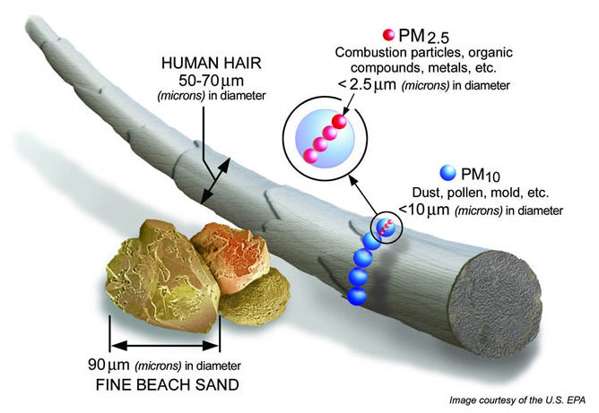
QUESTION & DATA
Should the US start wearing masks after a pandemic?
How long are we living in moderate and good conditions for air quality?
Does it really matter to the US population?
What is causing the air pollution?
Notes:
In a years timeframe. What percentage of time are we breathing in good air compared to moderate?

Slide 4
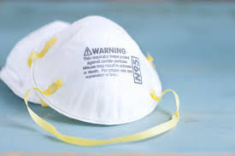
DATA CLEANUP & EXPLORATION
Data Sites:
EPA API
Census
Twitter
DMV

Slide 5
CONTENTS
Population & Location ( Hyun Soo Kim )
Seasons: Spring, Summer, Fall, Winter ( Christian )
Time of day (Christian)
Twitter data, by location about air pollution. ( Naz )
Twitter & Covid-19 (Naz)
How much pollution do cars give off? Which brand of car? ( Wayne )

Slide 6
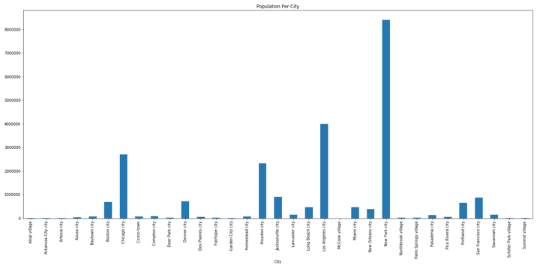
POPULATION
Goal
Look at multiple locations within U.S. (Population)
Results
No correlation throughout the country
Correlation exists for individual counties
Notes:
Background:
•Population from Census
•Air quality from EPA
•Looking at 2018 data
Assumption:
•Census was successful and accurate on capturing the population
•There was no major incident within U.S. to impact air quality
• Testing method and sampling methods were constant throughout
Result:
•Not a major deciding factor
•No correlation for U.S.
•Correlation exists under similar condition
•Strong correlation for county

Slide 7
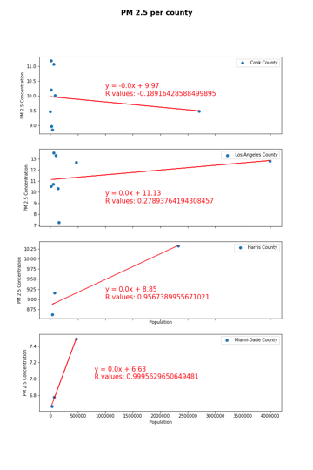
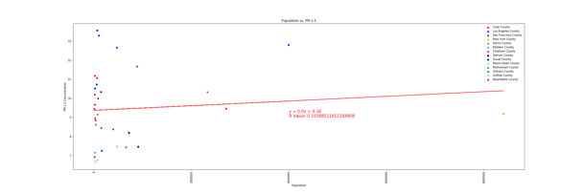
POPULATION Cont’d

Slide 8
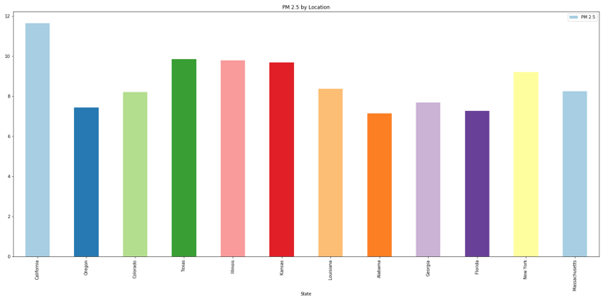
LOCATION
Goal
Find a trend by location within U.S. (Airflow)
Result
No clear cut pattern
West
East
Notes:
Hypothesis: Air quality is worse on the coast area (Air flow?)
Result:
•No definite answer
•Mid-west, mid-east looks as less pollution

Slide 9
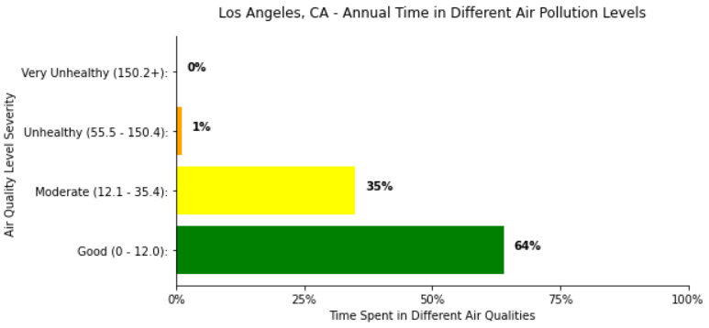
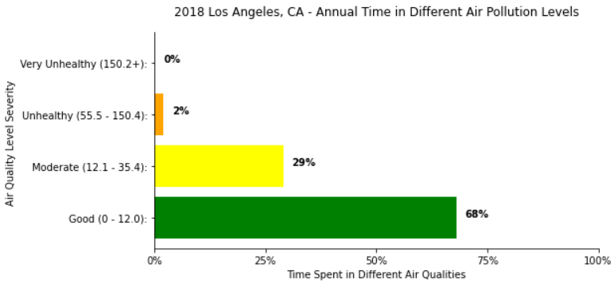
AIR QUALITY STANDARDS
How bad is bad?
How much good air are we really breathing?
Notes:
Epa.gov standards 0-12 good, 12-35 moderate, so on

Slide 10
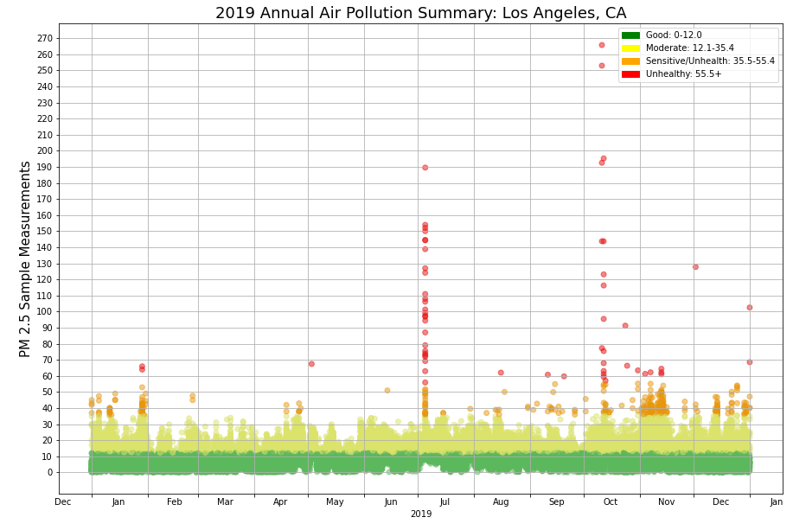
SEASONS: SUMMER, SPRING, FALL, WINTER
Los Angeles, CA
Seasonal change affecting air quality
Notes:
Ex: Holidays, CA Fires

Slide 11
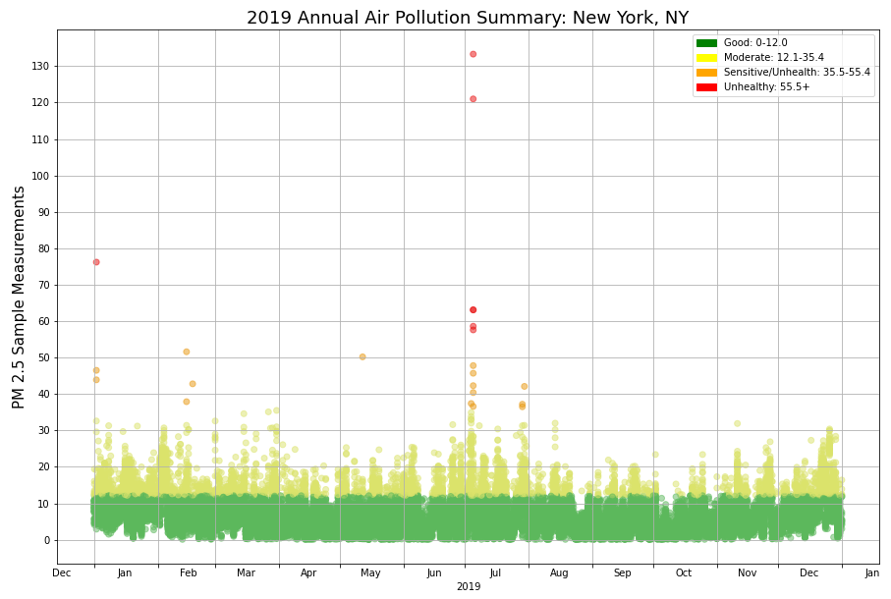
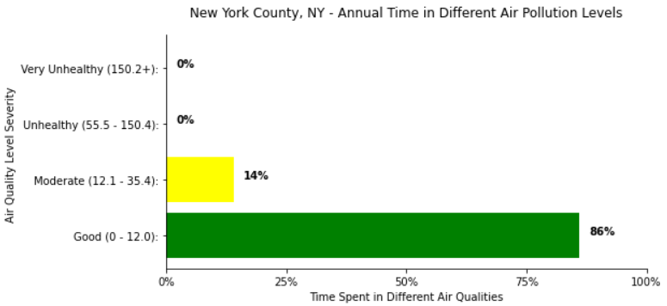
SEASONS: SUMMER, SPRING, FALL, WINTER
New York, NY
Seasonal change affecting air quality
Notes:
Ex: Holidays, Storms

Slide 12
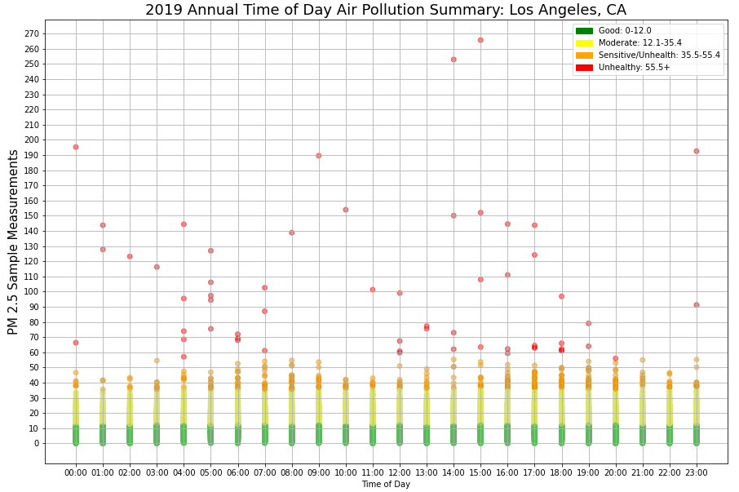
TIME OF DAY
Los Angeles, CA
Time of day difference?
Los Angeles: 64% in Good, 36% in Moderate
Others
Houston: 82% in Good, 18% in Moderate
New York: 86% in Good, 14% in Moderate
Notes:
When is a good time for me to not worry about air pollution in LA.
Lets see who else is talking about air pollution these days..

Slide 13



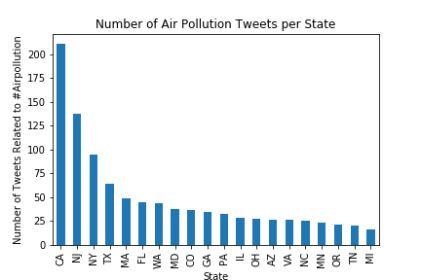
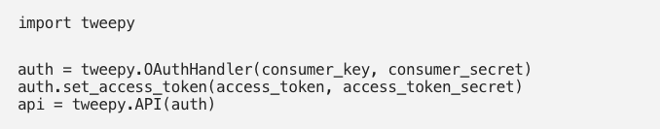
AIR POLLUTION TWITTER DATA, BY LOCATION
Does Air Pollution really matter to the US population?
API format for data collection.
Standard subscription is 7 days
Trending top 25 hashtags for air pollution from hashtag-generator tool, www.all-hashtag.com
Tweepy is a Python library for accessing the Twitter API
Data was collected by location globally and then by state
Notes:
Twitter Is An American Microblogging and Social Networking Service.
Which Users Post and Interact with messages known as “Tweets.”
Micro-blogs allow users to exchange small elements of content such as short sentences, individual images, or video Links

Slide 14
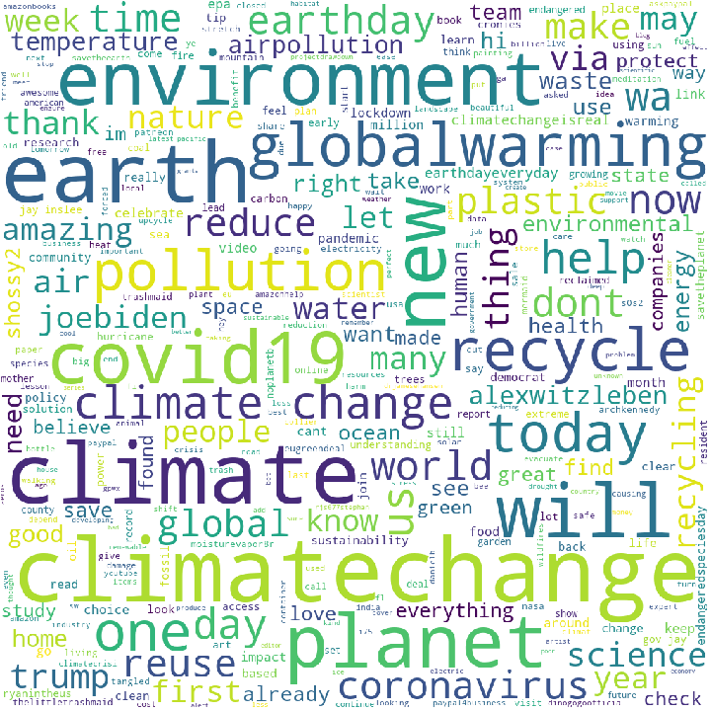
HOW MUCH POLLUTION DO CARS GIVE OFF? WHICH BRAND OF CAR?
TWITTER WORD CLOUD – DATA VISUALIZATION
Twitter Word Cloud based on information pulled for the US.
The size if each word indicates its frequency of importance
The top trending words aren’t a surprise however you can see other words such as Covid-19 and Corona Virus which have much to do with what is going on with our current status
Also you will see Trump and Joe Biden which could be due to the upcoming elections.
Notes:
Consider talking about:
Asthma
Heart Disease
Infection and cancer
Central nervous system

Slide 15
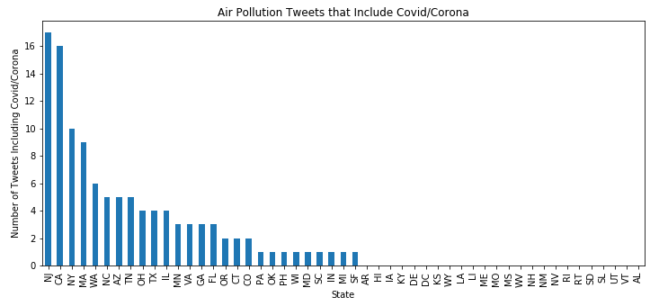
AIR POLLUTION DATA THAT INCLUDES CORONA VIRUS & COVID -19
There are quite a number of tweets that include corona virus and covid-19.
This is linked to people tweeting pictures about less smog and pollution in the air due to the quarantine.
Or if you live in a more polluted area you are more susceptible to catching the virus?
Links to Articles:
Is air pollution making the coronavirus pandemic even more deadly?
Air pollution linked to far higher Covid-19 death rates, study finds

Slide 16
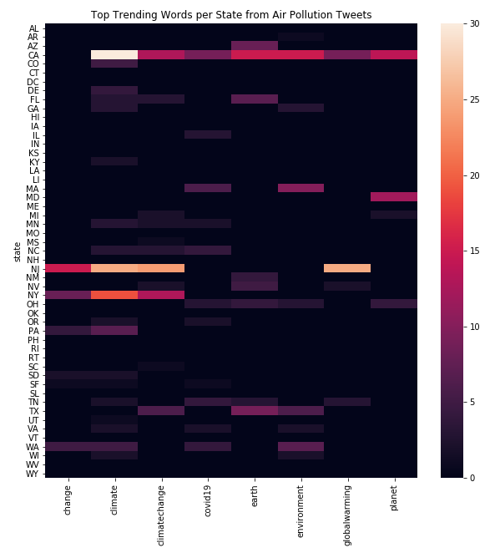
HEAT MAP OF TOP TRENDING WORDS PER STATE
Top 8 words: change, climate, climate change, covid-19, earth, environment, global warming, planet
Heatmap is used to show the frequency of importance for each word per state.

Slide 17
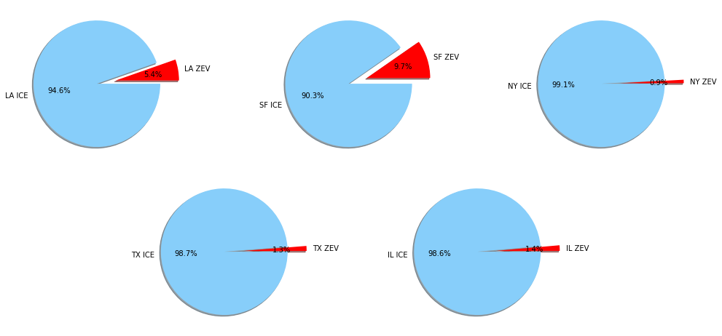
FUEL POLLUTION FROM VEHICLES

Slide 18
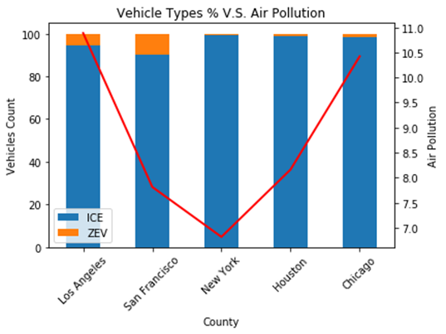
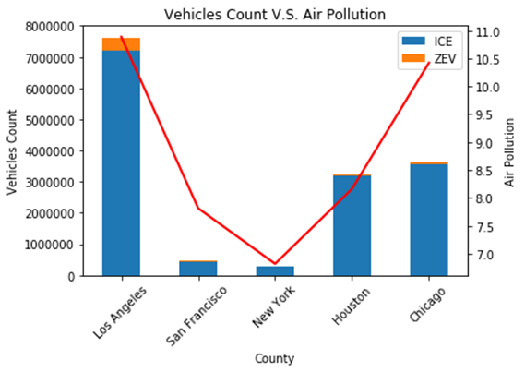
VEHICLES VS. AIR POLLUTION

Slide 19
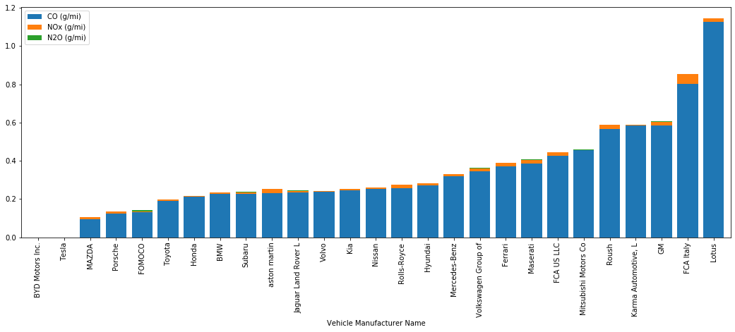
VEHICLES EMISSION RANKING
Consideration for your next car

Slide 20
CONCLUSION
Findings
Correlation to air pollution: population/location, combustion engine cars
Citizens of California, New Jersey, and New York are most aware of the air pollution
Los Angeles should be wearing mask. Oregon might not.
Challenge
Twitter API limitation
Tweepy library documentation
Data transparency / missing data / sampling location
Next
Improve API search
Additional types of air pollution / strength of impact

